Slide 1
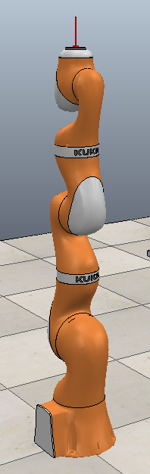
Welding Simulation with Kuka LBR iiwa 14 R820
-Varun Asthana
CNPM662: Project Presentation

Slide 2
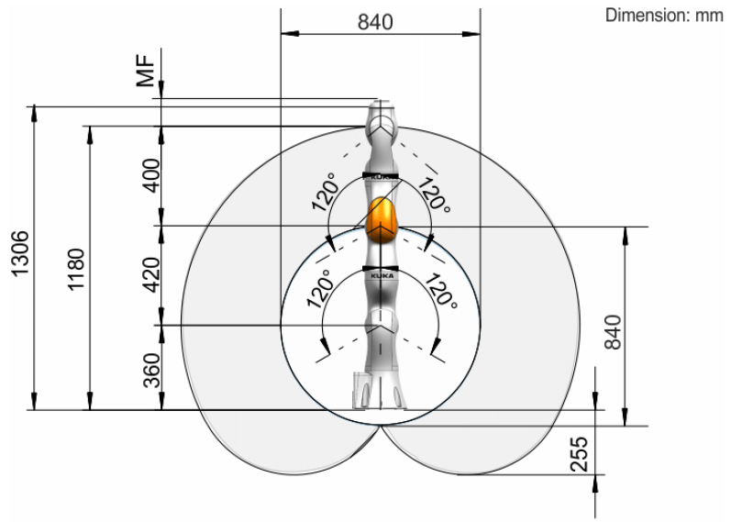
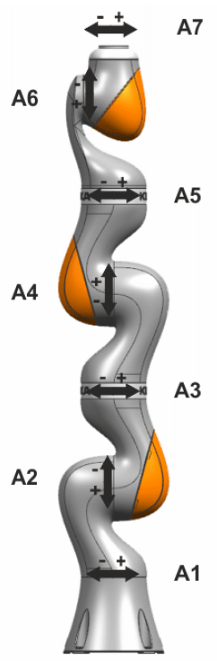
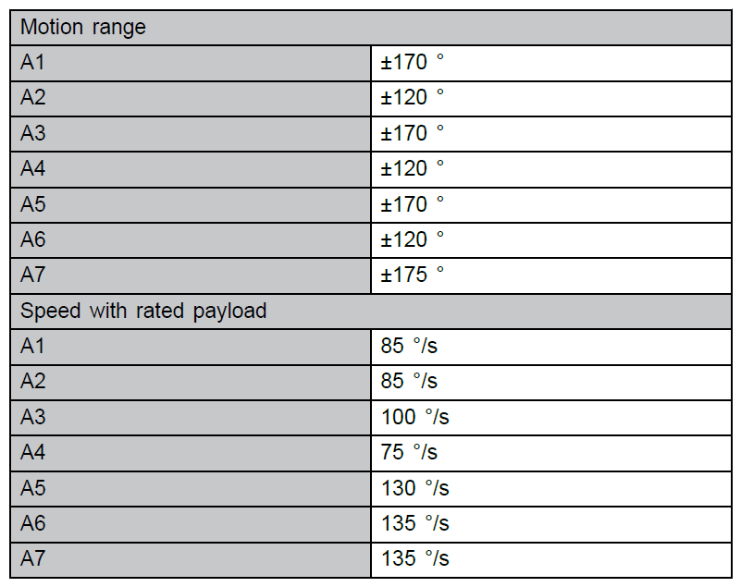
Robot Specifications
Kuka LBR iiwa 14 R820
Maximum reach: 820mm
Maximum payload: 14kgs.
Constraints on angular positions
Joint configuration of the arm-
RRRRRRR (7 revolute joints)

Slide 3
Forward Kinematics

Slide 4
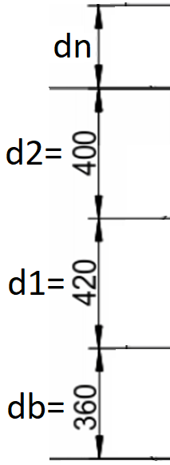
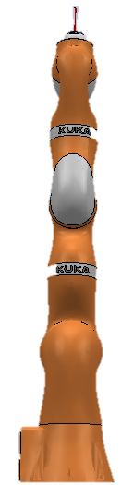
Forward Kinematics
zn
xn
z6
z4
z5
x5
x4
x6
Why rotating x-axis again and again by 180 degrees?
z4a
Frame assignment and DH table formation
x3
Due to the pre-defined local frames assigned to the joints in the vrep model
Correction of this by rotating the joints to simplify DH table was not feasible due to geometry deformation of the robot (because of pre-defined hierarchy tree of robot elements).
x4a
z3
z2
z0
z1
x1
x0
x2
zb
xb
‘b’ represents the base frame, which is same as world frame

Slide 5
Forward Kinematics
zn
Let us denote the joint parameters by:
t1, t2, t3, t4, t5, t6 and t7 respectively for joints 1 to 7, starting from bottom to top.
(here ‘t’ stands for theta, measured in degree)
xn
z6
z4
z5
x5
x4
DH Table
Frame | Theta_{i-1} | d_{i-1} | a_{i} | Alpha_{i}
b-0 | 0 | db | 0 | 0
0-1 | 180 + t1 | 0 | 0 | 90
1-2 | 180 + t2 | 0 | 0 | 90
2-3 | 180 + t3 | d1 | 0 | -90
3-4a | 180 + t4 | 0 | 0 | -90
4a-4 | 0 | d2 | 0 | 0
4-5 | 180 + t5 | 0 | 0 | 90
5-6 | 180 + t6 | 0 | 0 | 90
6-n | t7 | dn | 0 | 0
z4a
Frame assignment and DH table formation
x3
x4a
z3
z2
z0
z1
x1
x0
zb
xb
All A and T matrices are calculated using the above DH table.
‘b’ represents the base frame, which is same as world frame

Slide 6
Inverse Kinematics

Slide 7
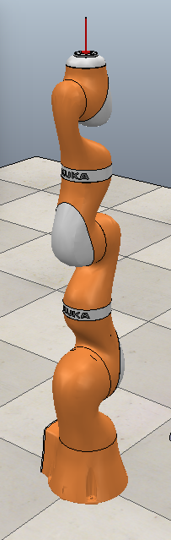
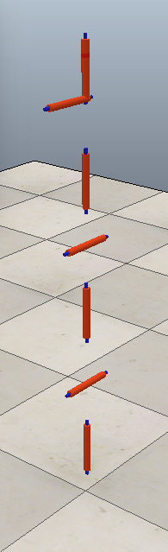
Inverse Kinematics
All the 3 highlighted axis coincide at a common point, called wrist center.
This allows the inverse kinematics problem to be decoupled into-
Inverse Position (bottom 4 joints), and
Inverse Orientation (top 3 joints)
Inverse Position and Inverse orientation decoupling
Under constrained system
Inverse positions of wrist center O_{c} i.e. 3 variables (x_{c}, y_{c}. z_{c}) are to be solved by using 4 joint parameters (t1 to t4). Hence infinite solutions exist.
Resolved with following assumption:
Locking joint 3, that is setting t3=0 degree

Slide 8
Inverse Kinematics
Solving Inverse Position
O_{c}
d2 cos(t2-t4)
z_{c}
d2
-t4
t2
d2 sin(t2-t4)
d1
d1 cos(t2)
t2
Inverse Position
d2 sin(t2-t4)
d1 sin(t2)
x_{c} = {d1*sin(t2) + d2*sin(t2-t4)}*cos(t1)
y_{c} = {d1*sin(t2) + d2*sin(t2-t4)}*sin(t1)
z_{c} = d0 + d1*cos(t2) + d2*cos(t2-t4)
db
y_{c}
t1
x_{c}
t1 = atan2 (yc/xc)
t4 = acos {((xc^2) + (yc^2) + (zcc^2) - (d1^2) - (d2^2))/(2*d1*d2)}
t2 is obtained by solving a quadratic in cos(t2)
which is depends on cos(t4)
Unique Solution
2 Solutions
4 Solution
Note: These solutions occur in pairs

Slide 9
Inverse Kinematics
Solving Inverse Orientation
Rwist = [R₇⁴ ]^{T} R_{d}^{b}
RHS of above equation is known, and LHS is unknown. LHS is a function of t5, t6 and t7. Hence solved by comparing.
t5 = atan2 (Rwrist(2,3)/Rwrist(1,3))
t6 = acos (Rwrist(3,3))
t7 = atan2 (Rwrist(3,2)/-Rwrist(3,1)) or
atan2 (-Rwrist(3,2)/Rwrist(3,1))
Unique Solution
2 Solutions
Inverse Orientation
2 Solutions
Note: These solutions occur in pairs
Defining R_{d}^{b} It is assumed that-
Object is parallel to the ground
Welding will take place at 45º from the –xb axis and will be directed from top to bottom.
xn
R_{d}^{b} = R_{x}(180) * R_{y}(45)
zn
45º
zb
xb

Slide 10
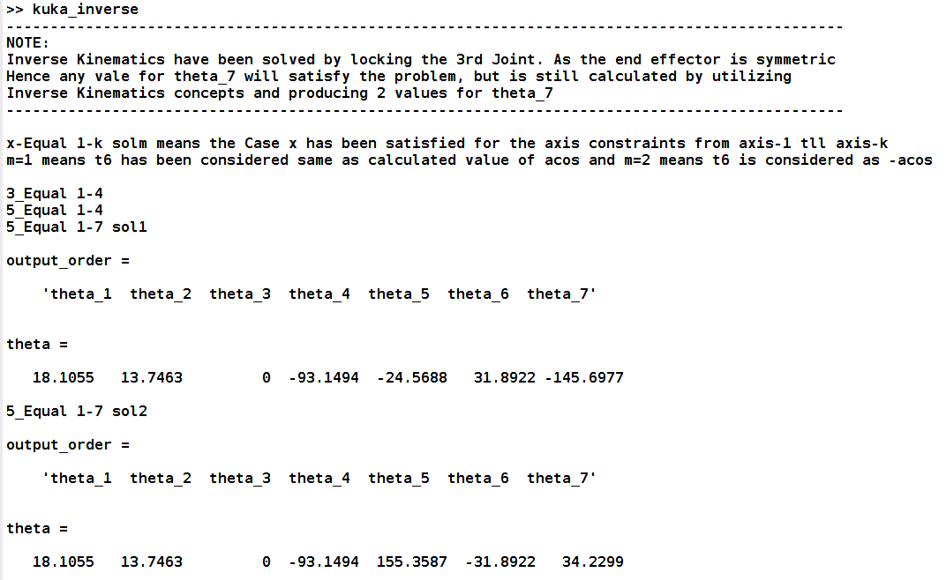
Results
MATLAB Output
FK & IK solved in MATLAB
Simulation done in vrep

Slide 11
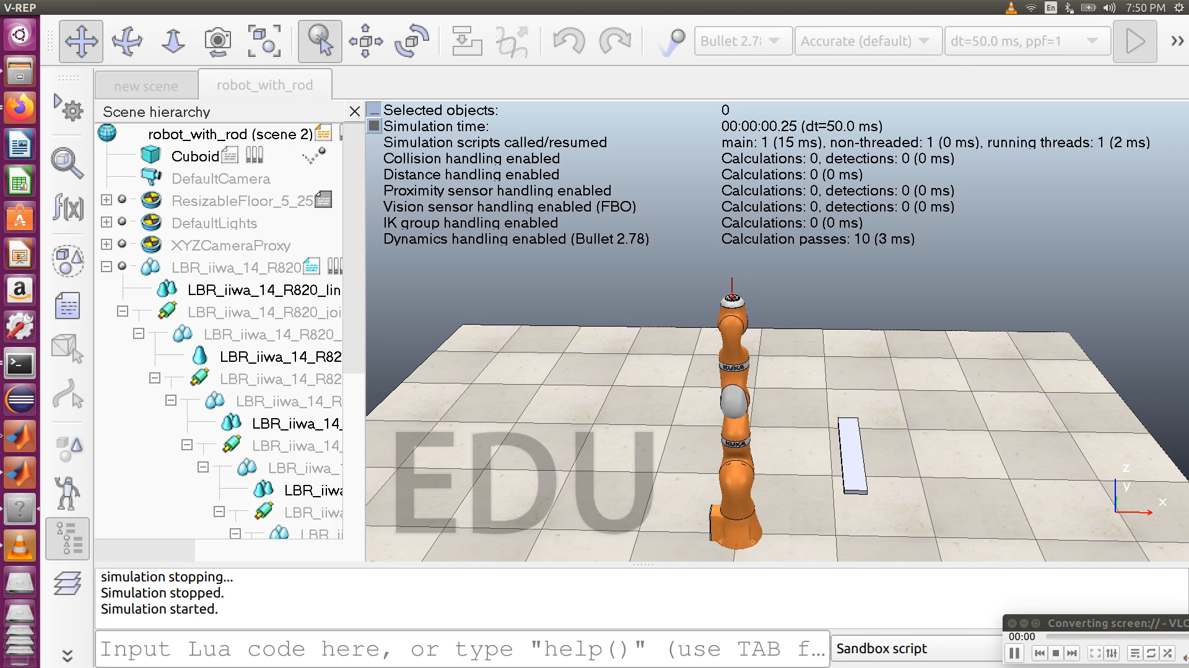
Results
VREP Simulation- Multiple Position and Orientation
FK & IK solved in MATLAB
Simulation done in vrep

Slide 12
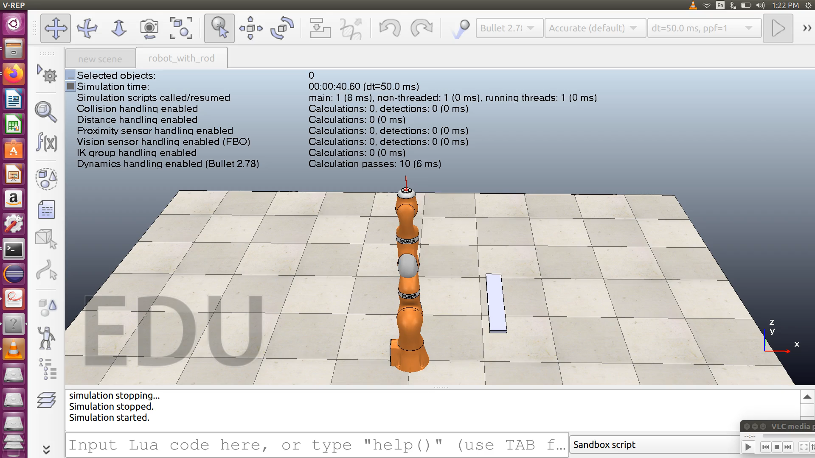
Results
VREP Simulation- Path Planning
FK & IK solved in MATLAB
Simulation done in vrep

Slide 13
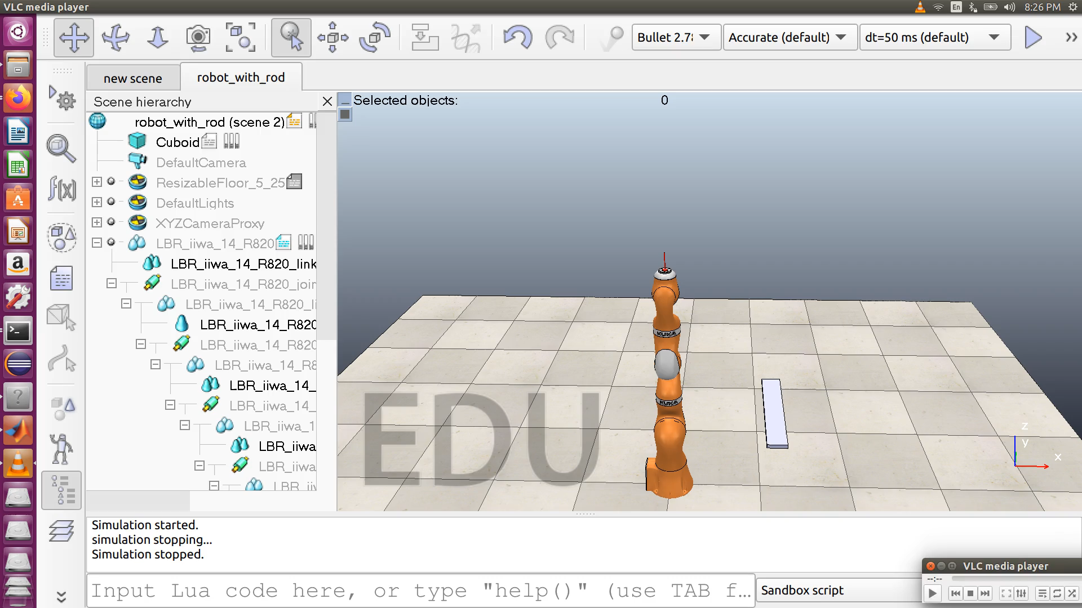
Results
VREP Simulation
t1 = atan2 (yc/xc)
atan2 (-yc/-xc)
Unique Solution
FK & IK solved in MATLAB
Simulation done in vrep

Slide 14
Thank You

